Slide 1
London’s bike sharing scheme to improve public health

Slide 2
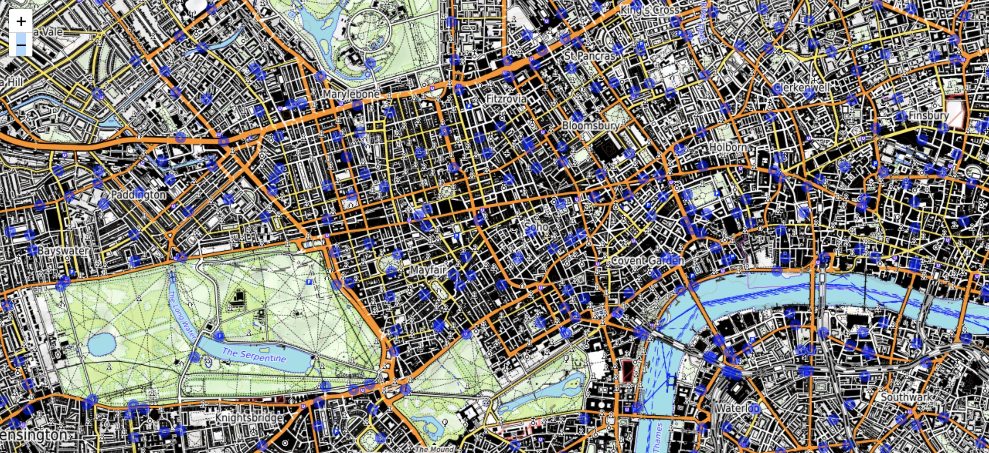
BikePoints are widely available in the center of London

Slide 3
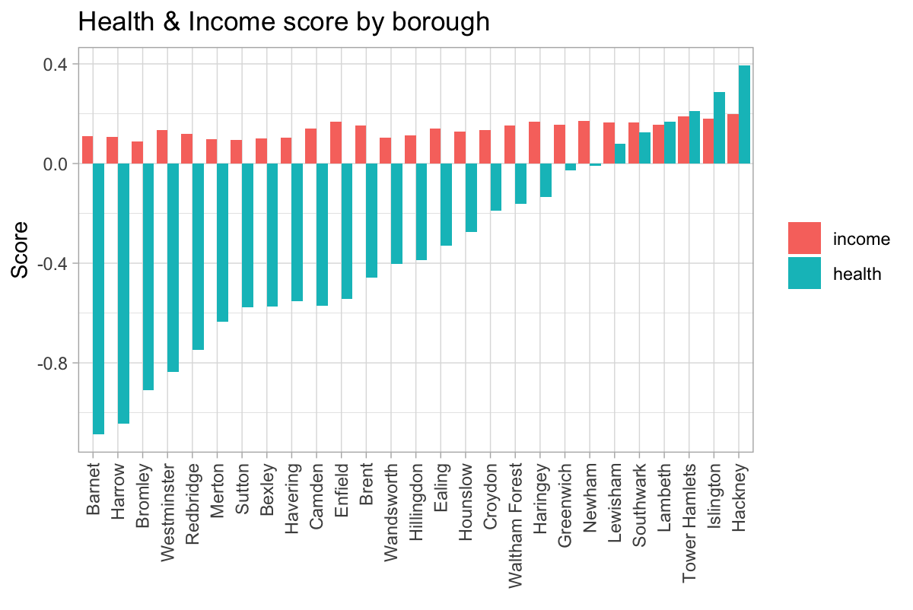
Interventions would have most impact in boroughs with lower levels of health
Hackney and Islington have greatest challenge.
Regular cycling would improve health.
Cycling could replace daily commute with public transport and save money.

Slide 4
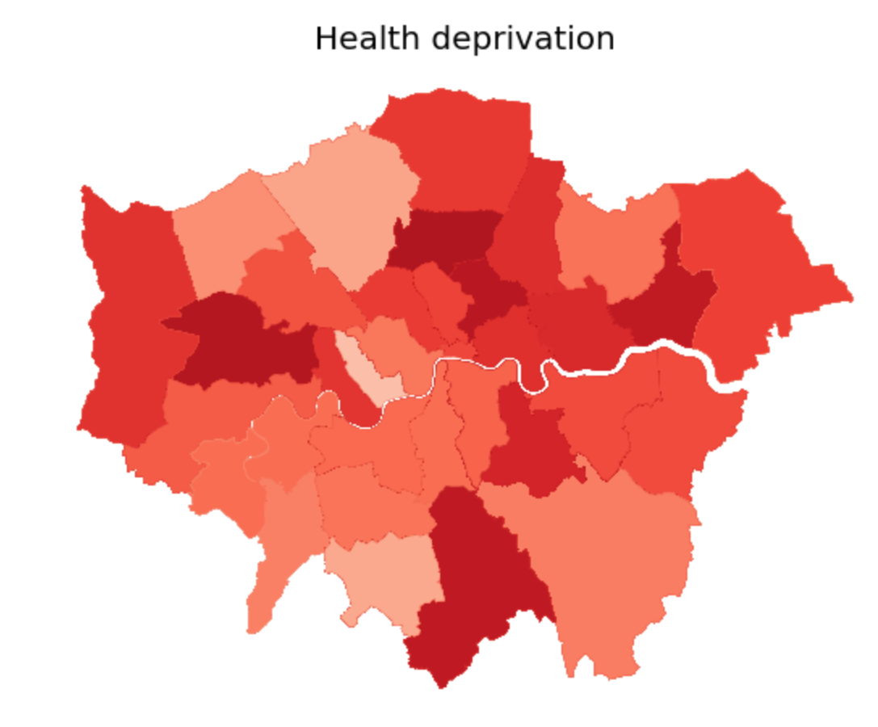
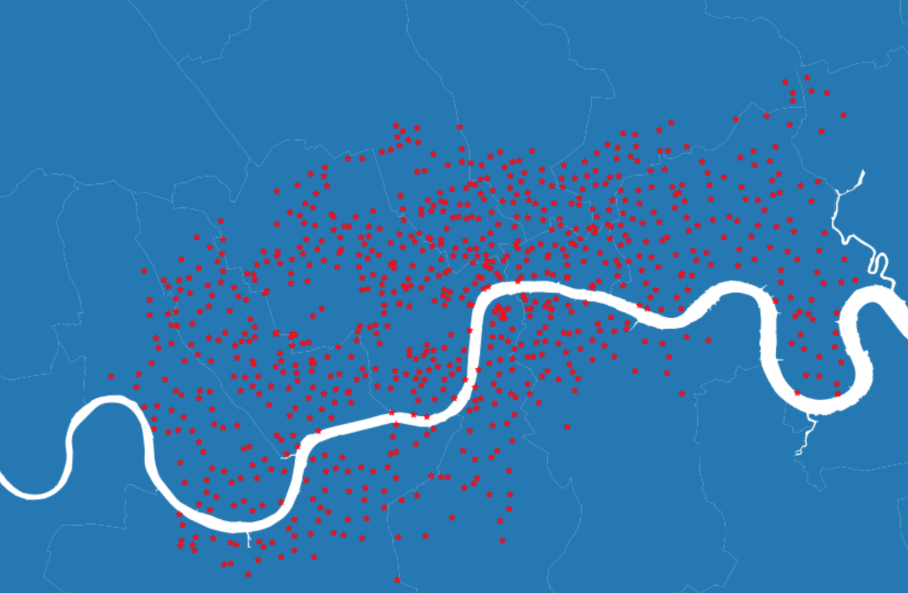
BikePoints should expand in those areas where they are most beneficial
BikePoint Location

Slide 5
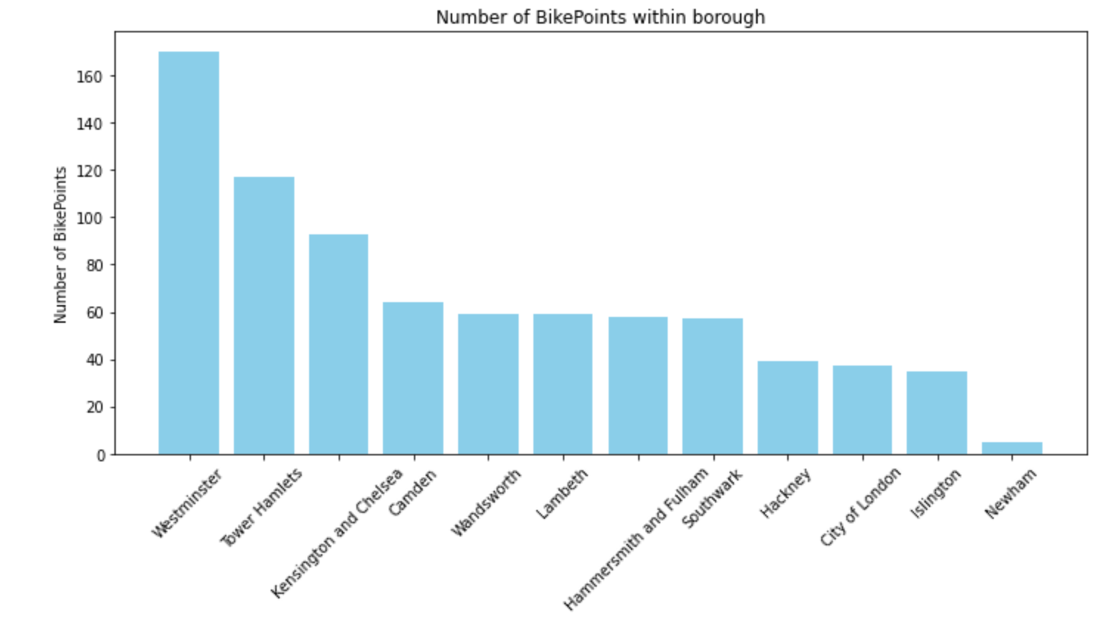
But there are fewer Bike Points in boroughs with greatest need
BikePoint expansion in Hackney and Islington have greater potential to improve public health
Safety has to be improved through designated routes on quieter streets

